Slide 1
Example
Brain Weight, Gestation, Mass, and Litter Size

Slide 2
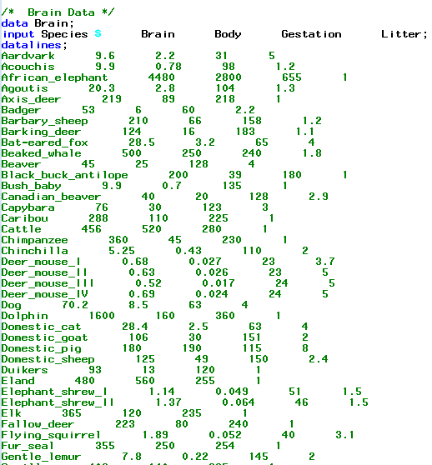
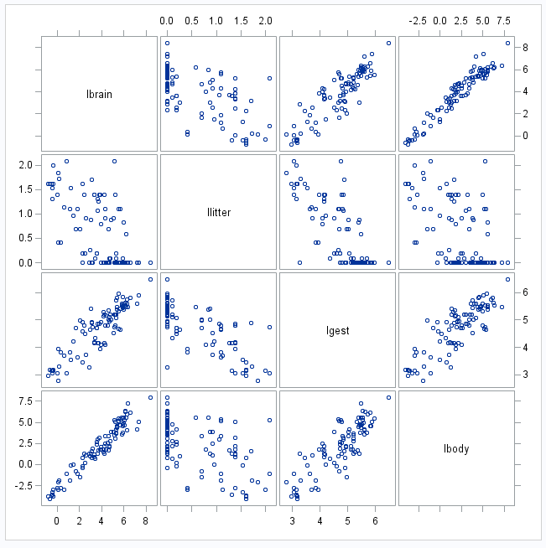
Partial Residuals: Brain Weight Data

Slide 3
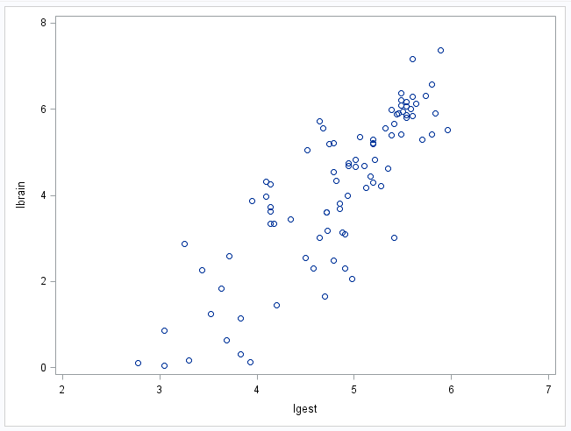
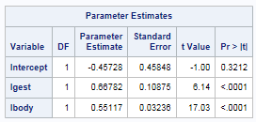
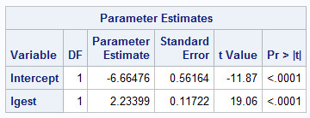
Partial Residuals: Brain Weight Data (cont.)

Slide 4
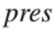
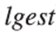
Partial Residuals
$$μ\left\{lbrain | lbody,lgest\right\}= β_{0}+β_{1}lbody+β_{2}lgest$$

Slide 5
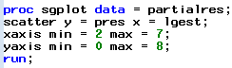
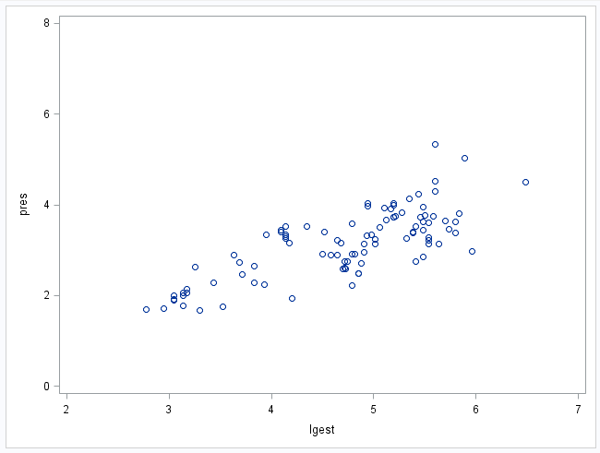
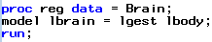
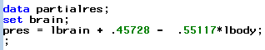
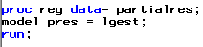
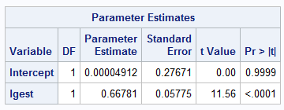
Partial Residuals: Brain Data
$$μ\left\{lbrain | lbody,lgest\right\}= β_{0}+β_{1}lbody+β_{2}lgest$$

Slide 6
Partial Residuals: A More Intuitive (but Equivalent) Approach
We need to “remove” the effect of lBody so we can see the relationship between lBrain and lGest without the effects of lBody interfering.
Find the residuals of lBrain when regressed on lBody. Call these lBrainres_body.
Find the residuals of lGest when regressed on lBody. Call these lGestres_body.
Now fit the model.
lBrainres_body = β₀ + β₁lGestres_body
We can interpret β₁ as the effect of lGest on lbrain after accounting for the effects of lBody.

Slide 8
Putting It All Together
Alcohol Metabolism Study

Slide 9
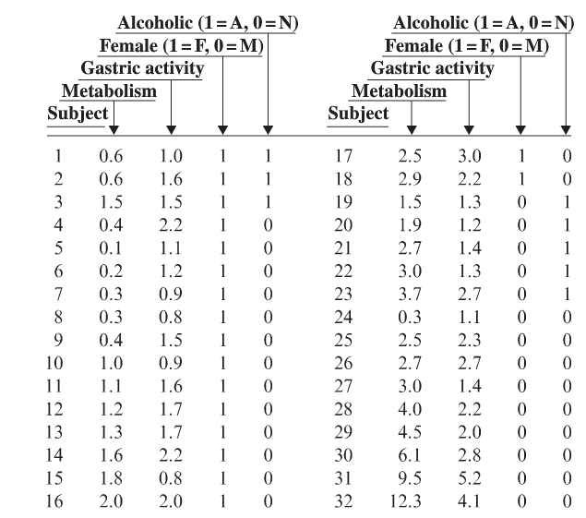
Example: Male Female Alcohol Metabolization
The subjects were 18 women and 14 men, all volunteers living in Trieste. Three of the women and ﬁve of the men were categorized as alcoholic. All subjects received ethanol, at a dose of 0.3 grams per kilogram of body weight, orally one day and intravenously another, in randomly determined order. Since the intravenous administration bypasses the stomach, the diﬀerence in blood alcohol concentration—the concentration after intravenous administration minus the concentration after oral administration—provides a measure of the “ﬁrst-pass metabolism” in the stomach. In addition, gastric alcohol dehydrogenase (AD) activity (activity of the key enzyme) was measured in mucus samples taken from the stomach linings. The data displayed to the right.
Several questions arise:
Do levels of ﬁrst-pass metabolism diﬀer between men and women?
Can the diﬀerences be explained by postulating that men have more dehydrogenase activity in their stomachs?
Are the answers to these questions complicated by an alcoholism eﬀect?

Slide 10
Alcohol Metabolization
Several questions arise
Do levels of ﬁrst-pass metabolism diﬀer between men and women?
Can the diﬀerences be explained by postulating that men have more dehydrogenase activity in their stomachs?
Are the answers to these questions complicated by an alcoholism eﬀect?

Slide 11
Steps in Multiple Regression
Plot the data.

Slide 12
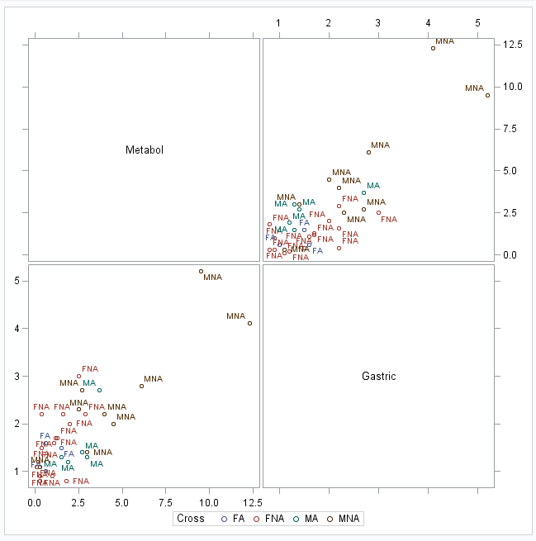
Plot the Data

Slide 13
Steps in Multiple Regression
Plot the data.
Develop a tentative model(s).
Using the question(s) of interest (QOI)
Accounting for confounders
Accounting for relationships (X², X³, etc.)

Slide 14
Alcohol Metabolization
Several questions arise.
Do levels of ﬁrst-pass metabolism diﬀer between men and women?
Can the diﬀerences be explained by postulating that men have more dehydrogenase activity in their stomachs?
Are the answers to these questions complicated by an alcoholism eﬀect?
$$Metab= β_{0}+β_{1}Gast+β_{2}Gender+β_{3}Alc+β_{4}GenderAlc+ β_{5}GenderGast$$
$$+β_{6}AlcGast+β_{7}GenderAlcGast$$

Slide 15
Steps in Multiple Regression
Plot the data.
Develop a tentative model(s).
Using the question(s) of interest (QOI)
Accounting for confounders
Accounting for relationships (X², X³, etc.)
Fit the model(s).
Evaluate residual plots.
Constant SD
Normality and zero mean
Identify any influential observations

Slide 16
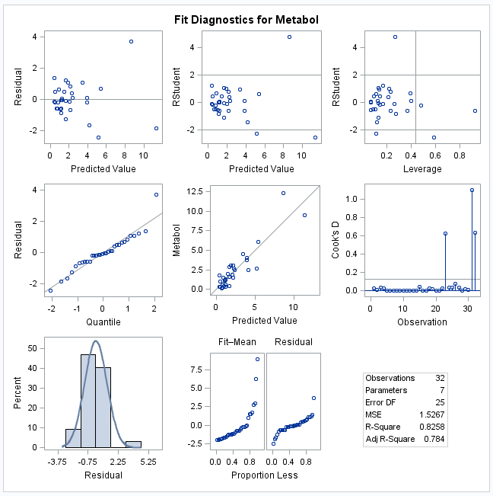
Residual Analysis for Metabolization of Alcohol Example

Slide 17
Strategy … High Leverage
Reduce the range of inference for X to {0, 3}.

Slide 18
Question 1
Do levels of ﬁrst-pass metabolism diﬀer between men and women?

Slide 19
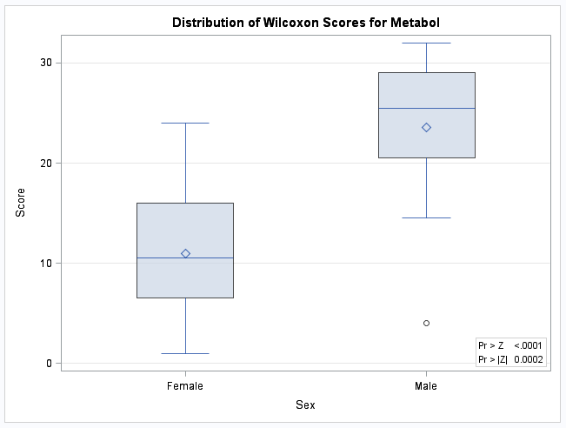
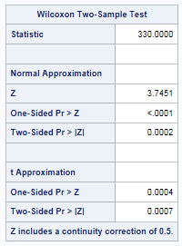
Question 1 (cont.)
Do levels of ﬁrst-pass metabolism diﬀer between men and women?
The evidence suggests (Z = 3.7451, pval < .0002 from rank-sum test) that the median of the first-pass male metabolism rate is different (higher) than that of female.

Slide 20
Question 3 Second
Are the answers to these questions complicated by an alcoholism eﬀect?

Slide 21
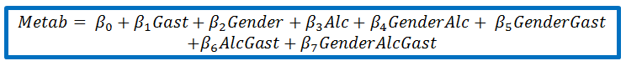
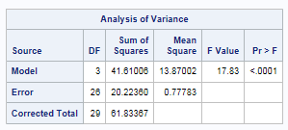
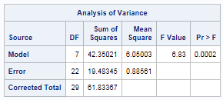
Extra Sum of Squares Test
Reduced
Full
 | Df | SS | MS | F | P
Model | 4 | .7401 | 0.185 | 0.21 | .93
Error | 22 | 19.4835 | 0.8856
Total | 26 | 20.2236
$$Metab= β_{0}+β_{1}Gast+β_{2}Gender+ β_{5}GenderGast$$
The data are consistent with no alcoholism effect—for those with gastric levels between 0 and 3.

Slide 22
Question 2 Last
Can the diﬀerences be explained by postulating that men have more dehydrogenase activity in their stomachs?

Slide 23
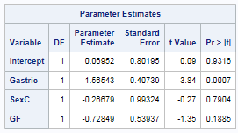

Question 2 Last
Can the diﬀerences be explained by postulating that men have more dehydrogenase activity in their stomachs?
$$Metab= β_{0}+β_{1}Gast+β_{2}Gender+ β_{5}GenderGast$$
Regression through the origin makes sense in this setting. No enzyme equates to no metabolization of alcohol.
$$Metab= β_{1}Gast+ β_{5}GenderGast$$

Slide 24
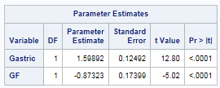
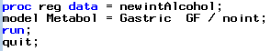

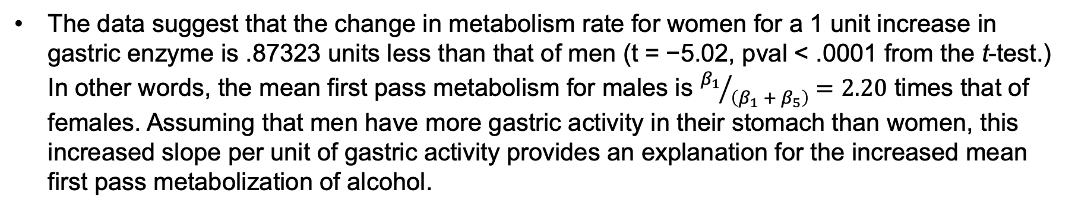
Question 2 Last (cont.)
Can the diﬀerences be explained by postulating that men have more dehydrogenase activity in their stomachs?
$$Metab= β_{1}Gast+ β_{5}GenderGast$$
The data suggest that the change in metabolism rate for women for a 1 unit increase in gastric enzyme is .87323 units less than that of men (t = −5.02, pval < .0001 from the t-test.) In other words, the mean first pass metabolism for males is ${β_{1}}/{\left(β_{1} + β_{5}\right)}=2.20$ times that of females. Assuming that men have more gastric activity in their stomach than women, this increased slope per unit of gastric activity provides an explanation for the increased mean first pass metabolization of alcohol.

Slide 26
A Step Through Stepwise Variable Selection (with the p-Value)

Slide 27
Example: Cement Data
Response y: heat evolved in calories during hardening of cement on a per gram basis
Predictor x₁: percentage of tricalcium aluminate
Predictor x₂: percentage of tricalcium silicate
Predictor x₃: percentage of tetracalcium aluminoferrite
Predictor x₄: percentage of dicalcium silicate

Slide 28
Example: Cement Data (cont.)

Slide 29
Stepwise Regression: The Idea
Start with no predictors in the “stepwise model.”
At each step, enter or remove a predictor based on t-tests.
Stop when no more predictors can be justifiably entered or removed from the stepwise model.

Slide 30
Stepwise Regression: Preliminary Steps
Specify a p-value-to-enter (p-value_{E} = 0.15) significance level
Specify a p-value-to-remove (p-value_{R} = 0.15) significance level

Slide 31
Example: Cement Data
Note the strong correlation between x2 and x4.

Slide 32
Predictor | Coef | SE Coef | T | P
Constant | 81.479 | 4.927 | 16.54 | 0.000
x1 | 1.8687 | 0.5264 | 3.55 | 0.005
Predictor | Coef | SE Coef | T | P
Constant | 57.424 | 8.491 | 6.76 | 0.000
x2 | 0.7891 | 0.1684 | 4.69 | 0.001
Predictor | Coef | SE Coef | T | P
Constant | 110.203 | 7.948 | 13.87 | 0.000
x3 | −1.2558 | 0.5984 | −2.10 | 0.060
Predictor | Coef | SE Coef | T | P
Constant | 117.568 | 5.262 | 22.34 | 0.000
x4 | −0.7382 | 0.1546 | −4.77 | 0.001

Slide 33
Predictor | Coef | SE Coef | T | P
Constant | 103.097 | 2.124 | 48.54 | 0.000
x4 | −0.61395 | 0.04864 | −12.62 | 0.000
x1 | 1.4400 | 0.1384 | 10.40 | 0.000
Predictor | Coef | SE Coef | T | P
Constant | 94.16 | 56.63 | 1.66 | 0.127
x4 | −0.4569 | 0.6960 | −0.66 | 0.526
x2 | 0.3109 | 0.7486 | 0.42 | 0.687
Predictor | Coef | SE Coef | T | P
Constant | 131.282 | 3.275 | 40.09 | 0.000
x4 | −0.72460 | 0.07233 | −10.02 | 0.000
x3 | −1.1999 | 0.1890 | −6.35 | 0.000

Slide 34
Predictor | Coef | SE Coef | T | P
Constant | 71.65 | 14.14 | 5.07 | 0.001
x4 | −0.2365 | 0.1733 | −1.37 | 0.205
x1 | 1.4519 | 0.1170 | 12.41 | 0.000
x2 | 0.4161 | 0.1856 | 2.24 | 0.052
Predictor | Coef | SE Coef | T | P
Constant | 111.684 | 4.562 | 24.48 | 0.000
x4 | −0.64280 | 0.04454 | −14.43 | 0.000
x1 | 1.0519 | 0.2237 | 4.70 | 0.000
x3 | −0.4100 | 0.1992 | −2.06 | 0.070

Slide 35
Predictor | Coef | SE Coef | T | P
Constant | 52.577 | 2.286 | 23.00 | 0.000
x1 | 1.4683 | 0.1213 | 12.10 | 0.000
x2 | 0.66225 | 0.04585 | 14.44 | 0.000

Slide 36
Predictor | Coef | SE Coef | T | P
Constant | 71.65 | 14.14 | 5.07 | 0.001
x1 | 1.4519 | 0.1170 | 12.41 | 0.000
x2 | 0.4161 | 0.1856 | 2.24 | 0.052
x4 | −0.2365 | 0.1733 | −1.37 | 0.205
Predictor | Coef | SE Coef | T | P
Constant | 48.194 | 3.913 | 12.32 | 0.000
x1 | 1.6959 | 0.2046 | 8.29 | 0.000
x2 | 0.65691 | 0.04423 | 14.85 | 0.000
x3 | 0.2500 | 0.1847 | 1.35 | 0.209

Slide 37
Predictor | Coef | SE Coef | T | P
Constant | 52.577 | 2.286 | 23.00 | 0.000
x1 | 1.4683 | 0.1213 | 12.10 | 0.000
x2 | 0.66225 | 0.04585 | 14.44 | 0.000

Slide 38
Stepwise regression: y versus x1, x2, x3, x4 Alpha-to-enter: 0.15; alpha-to-remove: 0.15 Response is y on 4 predictors, with N = 13
Step | 1 | 2 | 3 | 4
Constant | 117.57 | 103.10 | 71.65 | 52.58
x4 | −0.738 | −0.614 | −0.237
t-value | −4.77 | −12.62 | −1.37
p-value | 0.001 | 0.000 | 0.205
x1 |  | 1.44 | 1.45 | 1.47
t-value |  | 10.40 | 12.41 | 12.10
p-value |  | 0.000 | 0.000 | 0.000
x2 |  |  | 0.416 | 0.662
t-value |  |  | 2.24 | 14.44
p-value |  |  | 0.052 | 0.000
S | 8.96 | 2.73 | 2.31 | 2.41
R-Sq | 67.45 | 97.25 | 98.23 | 97.87
R-Sq(adj) | 64.50 | 96.70 | 97.64 | 97.44
C-p | 138.7 | 5.5 | 3.0 | 2.7

Slide 39
Caution about Stepwise Regression!
Do not jump to the conclusion:
That all the important predictor variables for predicting y have been identified, or
That all the unimportant predictor variables have been eliminated

Slide 40
Caution about Stepwise Regression! (cont.)
Many t-tests are conducted in a stepwise regression procedure
The probability is high:
That we included some unimportant predictors
That we excluded some important predictors

Slide 41
Drawbacks of Stepwise Regression
The final model is not guaranteed to be optimal in any specified sense.
Stepwise regression is sensitive to models with high multicollinearity.
The procedure yields a single final model, although in practice there are often several equally good models.
It doesn’t take into account a researcher’s knowledge about the predictors.

Slide 42
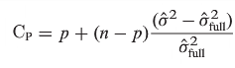
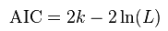
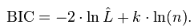
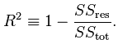
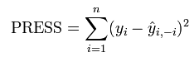
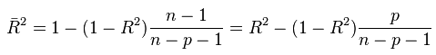
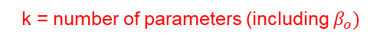
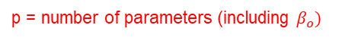
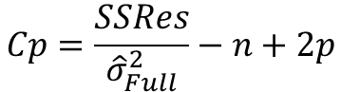
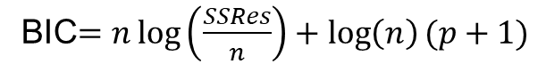
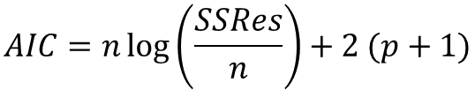
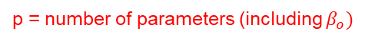
Variable Selection Criteria
There are many other criteria to perform variable selection with besides the F or t statistics!
Here are a few:
Smaller the Better
Smaller the Better/Closest to p
k = number of parameters (including $β_{o})$
p = number of parameters (including $β_{o})$
$$AIC=n\log\left(\frac{SSRes}{n}\right)+2 (p+1)$$
$$Cp=\frac{SSRes}{{\hat{σ}}_{Full}^{2}}−n+2p$$
BIC$=n\log\left(\frac{SSRes}{n}\right)+\log\left(n\right)(p+1)$
Larger the Better
p = number of parameters (including $β_{o})$
Assuming no overfit.
L = Max(likelihood function), will learn in later course.
p = number of predictors

Slide 44
Example
SAT and Student Dollars ($AT)!

Slide 45
Example 2: SAT Analysis QOI and Data
QOI: A common discussion in education is if, and to what extent, spending money on students is significantly associated with increased test scores. We would like to conduct an analysis to quantify any evidence that the amount of money spent on each student (Expend) is associated with an increase in the average SAT score for that state after accounting for possible confounding factors that have been recorded in the data set.
The data (50 observations … one for each state):
SAT: average SAT score for the state
Takers: percentage of the state’s students who take the test
Income: median income of families in the state
Years: average number of years students received formal education in social studies, natural sciences, and humanities
Public: percentage of test takers who attend public schools
Expend: amount of money in $100s that the state spends on each student
Rank: median percentile rank of the students in their secondary school

Slide 46
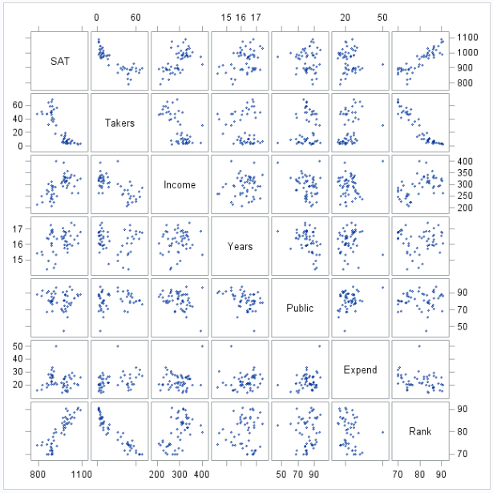
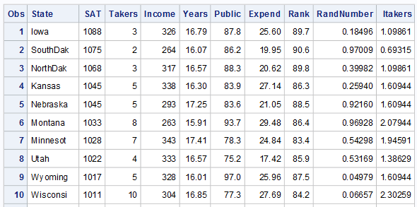
Example 2: SAT Analysis A Look at the Data
First 10 rows!

Slide 47
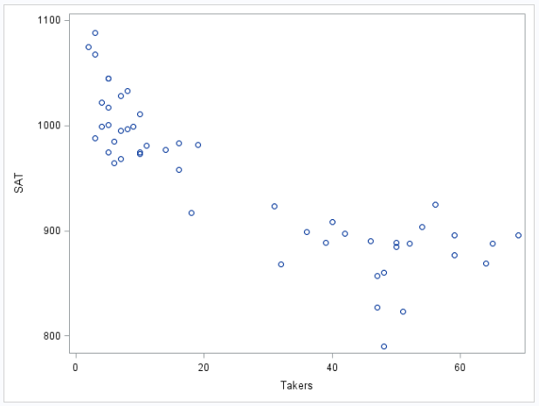
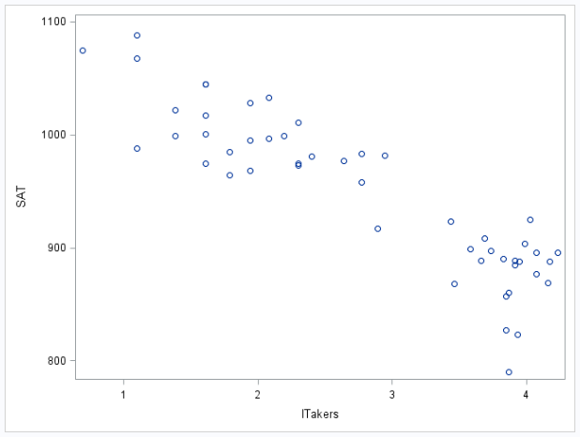
Example 2: SAT Analysis Tentative Model
Judging from the scatter plot, it looks like takers may need to be transformed to achieve a linear relationship with SAT scores.
We will try a log transform.
Takers
Log(Takers)
Our strategy here will be to try out various variable selection techniques to select those variables that may be associated with SAT score. Our variable of interest (Expend) will be excluded from this process and then added in later after the potential confounders have been identified. Note that we had to notice the necessary transformation and that the variable selection technique would have missed this crucial step.

Slide 48
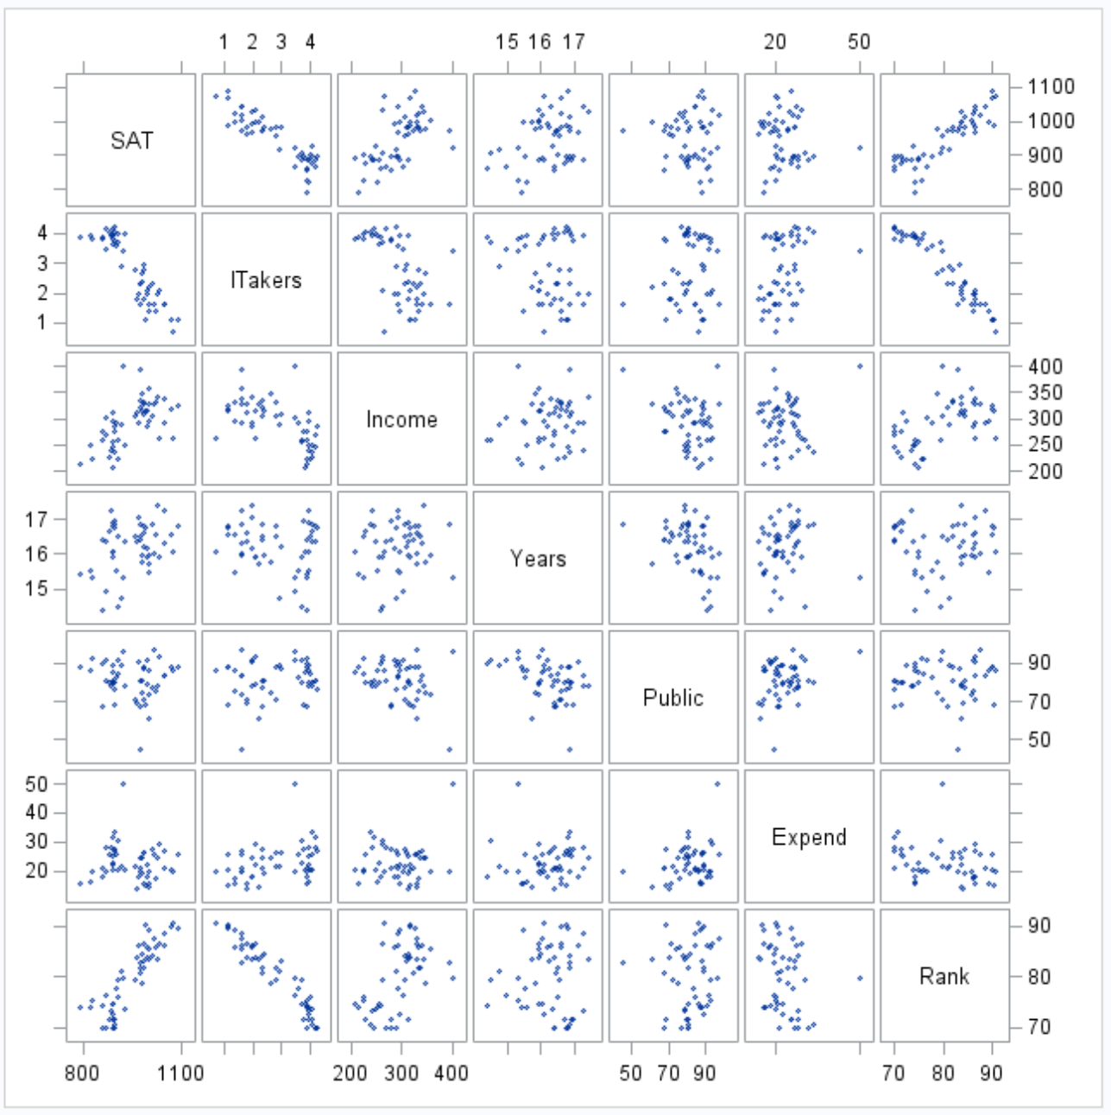
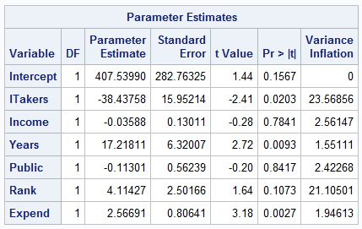
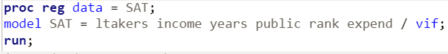
Example 2: SAT Analysis A Look at the VIFs
Tests multicollinearity
Guideline: VIF > 10 is a red flag

Slide 49
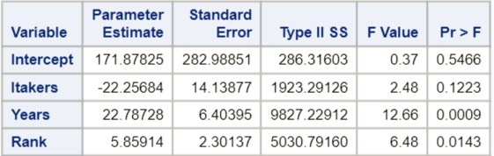
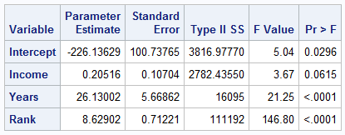
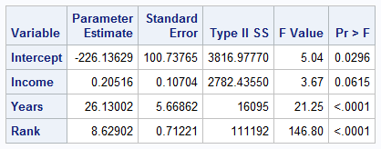
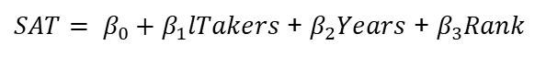
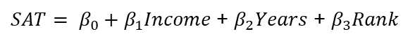
Example 2: SAT Analysis Model Selection (Adj R²)
$SAT= β_{0}+β_{1}lTakers$+ $β_{2}Years$ + $β_{3}Rank$
Forward
Adj r² = .8454
$SAT= β_{0}+β_{1}Income$+ $β_{2}Years$ + $β_{3}Rank$
Backward
Adj r² = .8491
$SAT= β_{0}+β_{1}Income$+ $β_{2}Years$ + $β_{3}Rank$
Stepwise
Adj r² = .8491

Slide 50
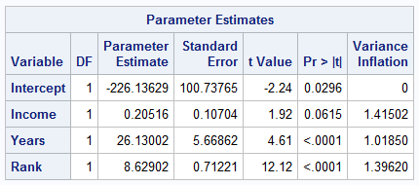
Example 2: SAT Analysis Check Residuals/Assumptions
$SAT= β_{0}+β_{1}Income$+ $β_{2}Years$ + $β_{3}Rank$
Judging from the scatter plots, there is no evidence against normality of SAT scores conditional on fixed values of income, years, and rank.
Judging from the scatter plots, there is no evidence against constant variance of SAT scores across values of income, years, and rank.
Judging from the matrix of scatter plots, there is no evidence against the assumption of linear trend between income, years, and rank and SAT scores.
We will assume all states’ SAT scores are independent.
Note the multicollinearity has been resolved as well (VIFS < 4).

Slide 51


Example 2: SAT Analysis Influential Observations
There do not appear to be any observations with both high leverage and high residual, nor do there appear to be any observations with notable Cook’s D. For this reason, no single observation appears to be extremely influential on its own.

Slide 52


Example 2: SAT Analysis Add Expenditure Back In
Clearly, the expenditure each state spends on its students (Expend) has a significant p-value, and judging from the residual plots, there does not seem to be significant evidence against the assumptions mentioned earlier. However, there does appear to be an influential point that has both very high leverage and residual as well as high Cook’s D.

Slide 53


Example 2: SAT Analysis Influential Point
Clearly, Alaska has an elevated expenditure and the thought is that it is colder in Alaska and thus a greater budget is needed to heat the school. Thus, those dollars are being spent on students but not on instruction. We will delete this observation.

Slide 54



Example 2: SAT Analysis Without Alaska
Clearly, the expenditure each state spends on its students (Expend) has a significant p-value and judging from the residual plots, there does not seem to be significant evidence against the assumptions mentioned earlier. After the exclusion of Alaska, there no longer appears to be an overly influential point. (It is important to note here that we didn’t delete Alaska because it was influential but because it was not a part of the population that we were interested in. That is, we have reason to believe that its relationship between SAT and expenditure is different than that of the other 49 states.)

Slide 55

Example 2: SAT Analysis Conclusion
After accounting for all other likely confounders (that we measured), and holding them fixed, we estimate that for each additional $100 spent on a student in the U.S. (excluding Alaska), the estimated mean SAT score increases 3.38514 points (p-value from MLR < .0001). A 95% confidence interval is (1.82, 4.95) points.

Slide 57
$AT Example in R

Slide 58
Example 2: SAT Analysis The Data
The Data (50 observations … one for each state):
SAT: average SAT score for the state
Takers: percentage of the state’s students who take the test
Income: median income of families in the state
Years: average number of years students received formal education in social studies, natural sciences, and humanities
Public: percentage of test takers who attend public schools
Expend: amount of money in $100s that the state spends on each student
Rank: median percentile rank of the students in their secondary school

Slide 59


Example 2: SAT Analysis A Look at the Data
First 6 rows!

Slide 60
Forward Selection in R
package = olsrr
Package: olsrr

Slide 61

Forward Selection in R: SAT Data, Part I

Slide 62

Forward Selection in R: SAT Data, Part II

Slide 63

Forward Selection in R: SAT Data, Part III

Slide 64

Forward Selection in R: SAT Data, Part IV

Slide 65

Forward Selection in R: SAT Data/Penter = .15

Slide 66

Deprecation: Out with the Old and in with the New

Slide 67
Backward Elimination in R, Part I
Package: olsrr

Slide 68

Backward Elimination in R, Part II

Slide 69

Backward Elimination in R, Part III

Slide 70

Backward Elimination in R, Part IV

Slide 71

Backward Elimination in R: Prem = .05

Slide 72

Deprecation Alert!

Slide 73


Sensitivity to Prem
In other words, the bigger the prem the more variables will be potentially selected into the model, and the smaller the prem, the fewer variables will be potentially selected into the model.

Slide 74

Stepwise Selection in R: Deprecated!
Package: olsrr

Slide 75

Stepwise Selection in R, Part I

Slide 76

Stepwise Selection in R, Part II

Slide 77

Stepwise Selection in R, Part III

Slide 78

Stepwise Selection in R/Pent = .05, Prem = .05

Slide 79





Example 2: SAT Analysis Fit the Model … Variable Selection
Forward
$SAT= β_{0}+β_{1}Rank$+ $β_{2}Years$ + $β_{3}Expend$
Backward
$SAT= β_{0}+β_{1}Rank$+ $β_{2}Years$ + $β_{3}Expend$
Stepwise
$SAT= β_{0}+β_{1}Rank$+ $β_{2}Years$ + $β_{3}Expend$

Slide 80


Example 2: SAT Analysis Fit the Model … Variable Selection (cont.)
Forward
$SAT= β_{0}+β_{1}Rank$+ $β_{2}Years$ + $β_{3}Expend$
Adj R² = .863
Backward
$SAT= β_{0}+β_{1}Rank$+ $β_{2}Years$ + $β_{3}Expend$
Adj R² = .863
Stepwise
$SAT= β_{0}+β_{1}Rank$+ $β_{2}Years$ + $β_{3}Expend$
Adj R² = .863
There is an easy choice of model here since all methods select the same model. If they did not all select the same model we could choose between models using the Adj R², AIC, C_{p}, or other statistic.

Slide 81


Example 2: SAT Analysis Check Residuals/Assumptions
$SAT= β_{0}+β_{1}Rank$+ $β_{2}Years$ + $β_{3}Expend$
Judging from the scatter plot of residuals, there is no evidence against normality of SAT scores conditional on fixed values of income, years, and rank.
Judging from the scatter plot of residuals, there is no evidence against constant variance of SAT scores across values of income, years, and rank.
Judging from the scatter plot of residuals, there is no evidence against the assumption of linear trend between income, years, and rank and SAT scores.
We will assume all states’ SAT scores are independent.
There are three observations with high residual that should be investigated as they may be highly influential points.

Slide 82

Example 2: SAT Analysis Check Residuals/Assumptions (cont.)
$SAT= β_{0}+β_{1}Rank$+ $β_{2}Years$ + $β_{3}Expend$
Judging from the scatter plot of residuals, there is no evidence against normality of SAT scores conditional on fixed values of income, years, and rank.
Judging from the scatter plot of residuals, there is no evidence against constant variance of SAT scores across values of income, years, and rank.
Judging from the scatter plot of residuals, there is no evidence against the assumption of linear trend between income, years, and rank and SAT scores.
We will assume all states’ SAT scores are independent.
There are three observations with high residual that should be investigated as they may be highly influential points: observations 50, 29, and 16.

Slide 84




Example 2: SAT Analysis Internal CV
$SAT= β_{0}+β_{1}Rank$+ $β_{2}Years$ + $β_{3}Expend$
# define training control
train_control<- trainControl(method="LOOCV")
# train the model
model<- train(SAT~Rank+Years+Expend, data=SAT, trControl=train_control, method="lm")
model
$SAT= β_{0}+β_{1}Rank$+ $β_{2}Years$ + $β_{3}Expend$
# define training control
train_control<- trainControl(method="LOOCV")
# train the model
model<- train(SAT~Rank+Years+Expend+Public, data=SAT, trControl=train_control, method="lm")
model

Slide 85
Mallow’s C_{p}
Best Subset Selection

Slide 86
Best Subset Regression
Best subsets regression:
Select the subset of predictors that does the best at meeting some well-defined objective criterion.

Slide 87
Mallow’s C_{p}
Mathematically: E(C_{p}) = p for a model with no overfit. For this reason the model with the C_{p} closest (smallest) to p is preferred. Note: “p” is the number of parameters (including the intercept) in the model.
For linear regression, the C_{p} statistic has been shown to be equivalent to the AIC.

Slide 88


Fishing for Explanation

Slide 89

C_{p} Plot

Slide 90

Residuals/Influential Points: lTakers, Years, Expend, Rank

Slide 91
Conclusion
One possible subset of the variables that explains the variation in SAT scores well (C_{p} = 4.0312, R² = .9107) are the lTakers, Rank, Years, and Expenditure variables.

Slide 92

Often Used Together
$SAT= β_{0}+β_{1}Income$+ $β_{2}Years$ + $β_{3}Rank\text{+ }β_{4}Expend$
Adj R²: .9025 C_{p} = 8.04
$SAT= β_{0}+β_{1}lTakers$+ $β_{2}Years$ + $β_{3}Rank\text{+ }β_{4}Expend$
Adj R²: .8821 C_{p} = 4.03
The model with lTakers, Years, Expend, and Rank looks to be having a smaller C_{p} statistic although the Income, Years, Rank, Expend has a greater adjusted R². In addition, it can be argued that lTakers and Rank look to be highly collinear and thus may be redundant, therefore providing additional support for the top model.
At this point, it is up to the researchers and/or the experts to weigh the pros and cons of each model. For our QOI, the top model seems to be a better choice since it accounts for income as a possible confounder and is backed up by our previous analysis. If the goal of the regression is to predict, you may not care about confounders or multicollinearity as much and may find in favor of the second model.
Finally, cross validation techniques, AIC, BIC, and SBC and other criteria are other valuable tools to help us decide between candidate models.

Slide 94
Introduction to PROC GLMSELECT

Slide 95



Variable Selection with PROC GLMSELECT

Slide 96




Model Comparison Using AIC/BIC/SBC
$SAT= β_{0}+β_{1}Income$+ $β_{2}Years$ + $β_{3}Rank\text{+ }β_{4}Expend$
$SAT= β_{0}+β_{1}lTakers$+ $β_{2}Years$ + $β_{3}Rank\text{+ }β_{4}Expend$
It is clear after this further analysis that there is strong evidence that the model with lTakers instead of Income is potentially a better model to assess the effect on expenditure after accounting for other variables.

